Slide 1
Data Science Research
Ting Yao

Slide 2
Data Description
ID: ID Number of Customers.
Warehouse block:- The Company have big Warehouse which is divided in to block such as A,B,C,D,E.
Mode of shipment:-The Company Ships the products in multiple way such as Ship, Flight and Road.
Customer care calls:- The number of calls made from enquiry for enquiry of the shipment.
Customer rating:- The company has rated from every customer. 1 is the lowest (Worst), 5 is the highest (Best).
Cost of the product-: Cost of the Product in US Dollars.
Prior purchases:- The Number of Prior Purchase.
Product importance:- The company has categorized the product in the various parameter such as low, medium, high.
Gender:- Male and Female.
Discount offered:- Discount offered on that specific product.
Weight in gms:- It is the weight in grams.
Reached on time:- It is the target variable, where 1 Indicates that the product has NOT reached on time and 0 indicates it has reached on time.

Slide 3
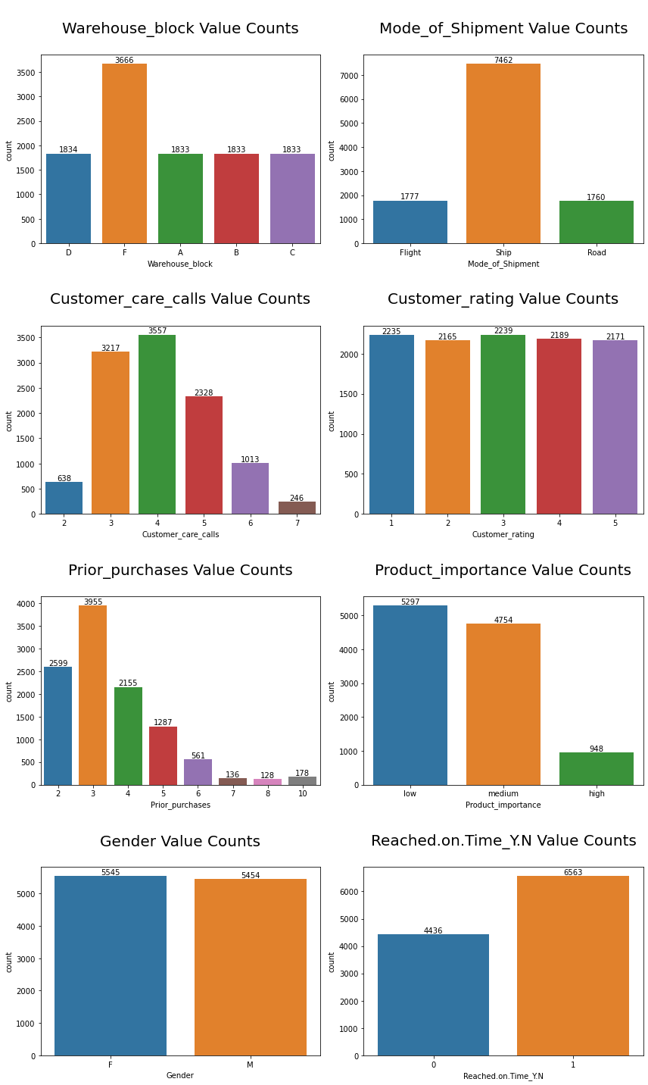
Countplot For Categorical Variable

Slide 4
Summary of the Countplot
Warehouse block F has the most shipment among all warehouses.
Most of the products are deliver by ship.
Most of the customers calls 3 or 4 times to the customer care centers.
Customer Ratings does not have much variation.
Most of the customers have 3 prior purchases.
Most of the products are of low and medium Importance.
Gender Column doesn't have much variance.
There are more products that are not delivered on time.

Slide 5
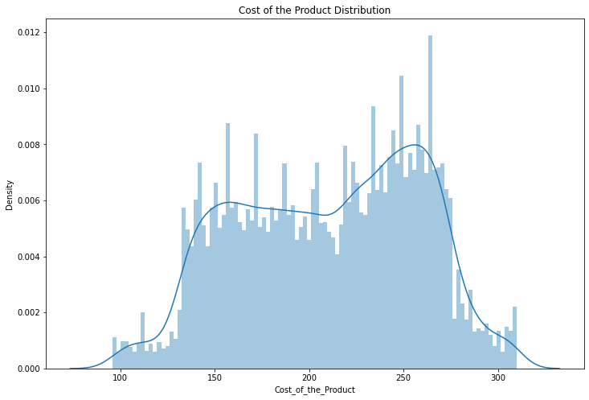
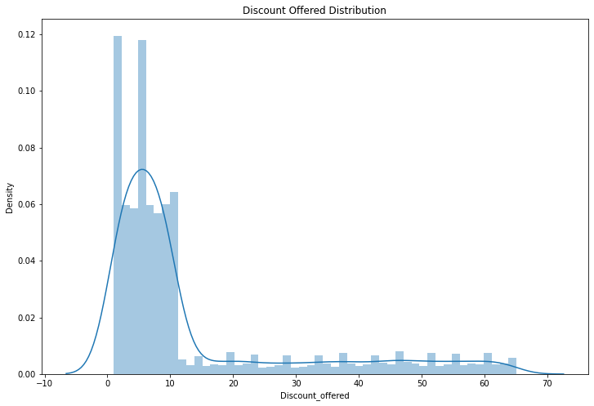
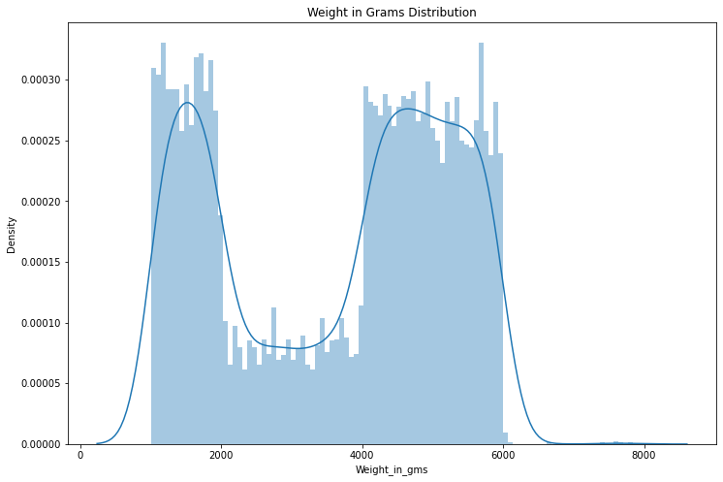
Distribution Plot of Numerical Variables

Slide 6
Summary of the Distribution Plot
Most products cost from 130 to 275
Most discounts offered are in the range of 0% to 10%
Most products weighs from 1000 grams to 2000 grams and from 4000 grams to 6000 grams

Slide 7
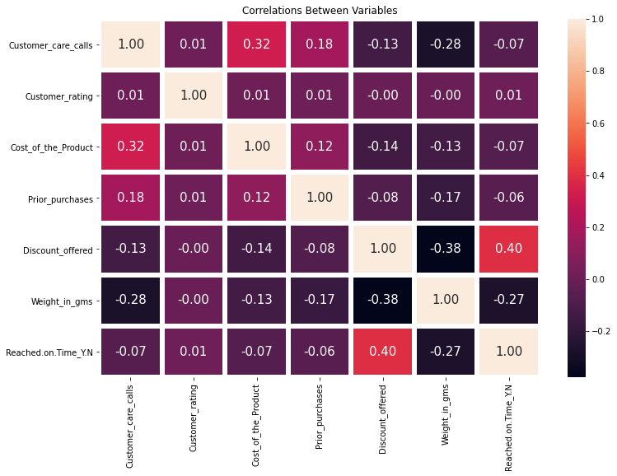
Variable Correlation Heat Map
Cost of the product is moderately correlated to customer care calls with a value of 0.32
Prior purchases is slightly correlated to customer care calls with a value of 0.18
Weight in grams is moderately correlated to customer care calls with a value of -0.28
Weight in grams is moderately correlated to discount offered with a value of -0.38
Reached on time is strongly correlated to discount offered with a value of 0.40
Reached on time is moderately correlated to weight in grams with a value of -0.27

Slide 8
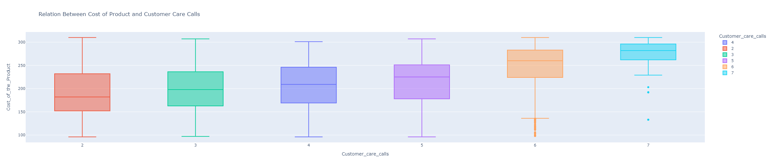
Relationship Between Cost of Product and Customer Care Calls
As the cost of product increases, the number of customer care calls increases as well.
I think customers tend to care more about their purchases if the cost of the products is higher because they would like to receive products that can be justified by their prices.
If the cost of product is low, customers tend to notice less about its flaws so the customer care calls might be fewer.
My suggestion to the company is to spend more on ensuring the quality of all products to make cost of customer services lower

Slide 9
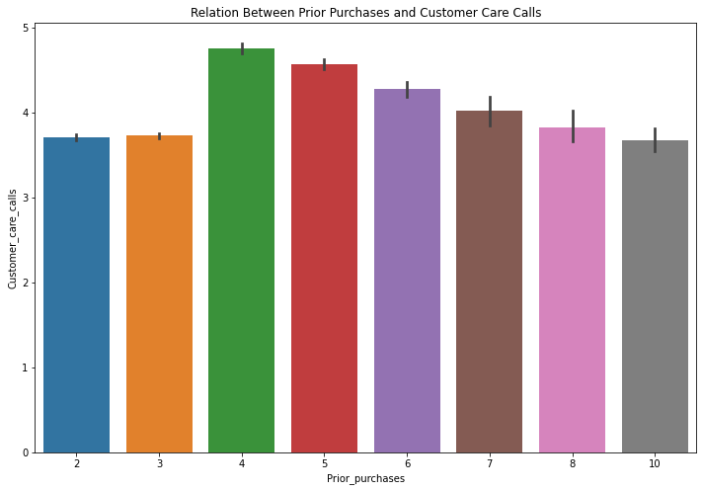
Relationship Between Prior Purchases and Customer Care Calls
The number of customer care calls are relatively similar among all numbers of prior purchases, so I do not think the two variables are correlated.

Slide 10
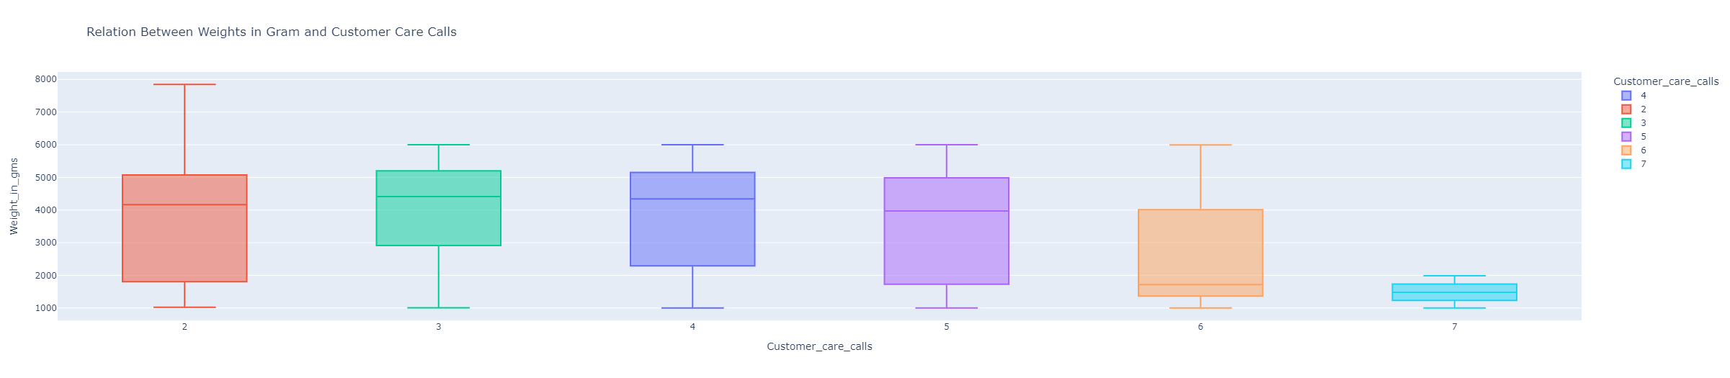
Relationship Between Weights in Gram and Customer Care Calls
Products of low weights tend to get more customer care calls.
I think lighter and smaller products tend to get lost easier than larger products.
The company should design stricter procedures for shipping to prevent products from missing.

Slide 11
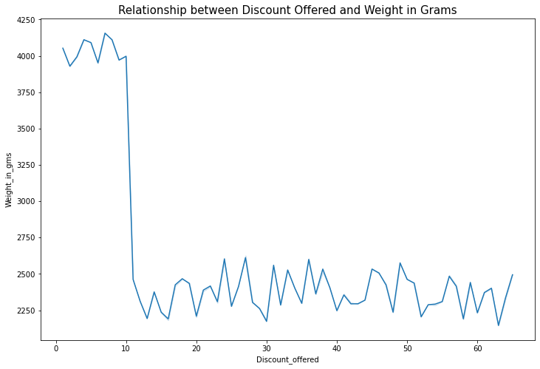
Relationship Between Discount Offered and Weights in Grams
Larger products get less discount.
It might be because the cost of manufacturing and shipping larger products are a lot higher so the revenue generated might be limited.
To get more sales in large products, the company could try to a bigger to discount for some events and ship them together to lower the cost.

Slide 12
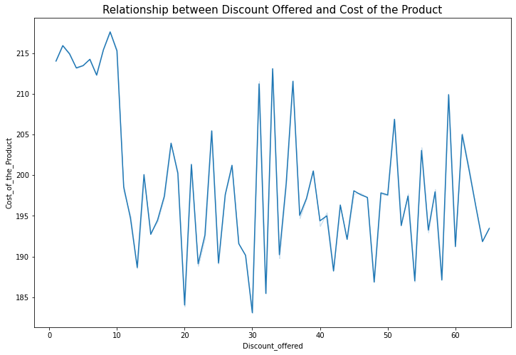
Relationship Between Discount Offered and Cost of the Product
Products that have the lowest discount rate tends to be the most expensive products.

Slide 13
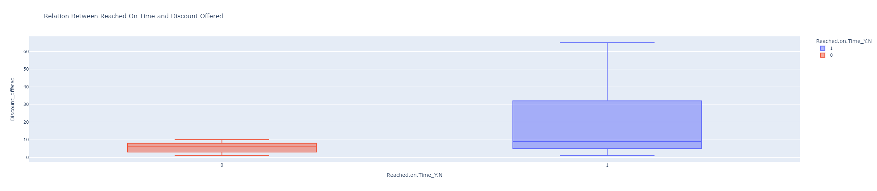
Relationship Between Reached On Time and Discount Offered
Most products that are not delivered on time are the ones that have higher discount rate.
This boxplot verifies my previous point that to make more profits on discounted products, the company would wait for all products to ship together to save cost of shipping.
We can tell from previous graphs that products that have low discount rates tend to be larger and more expensive. The more expensive shipping plan might help the products to deliver on time as well.

Slide 14
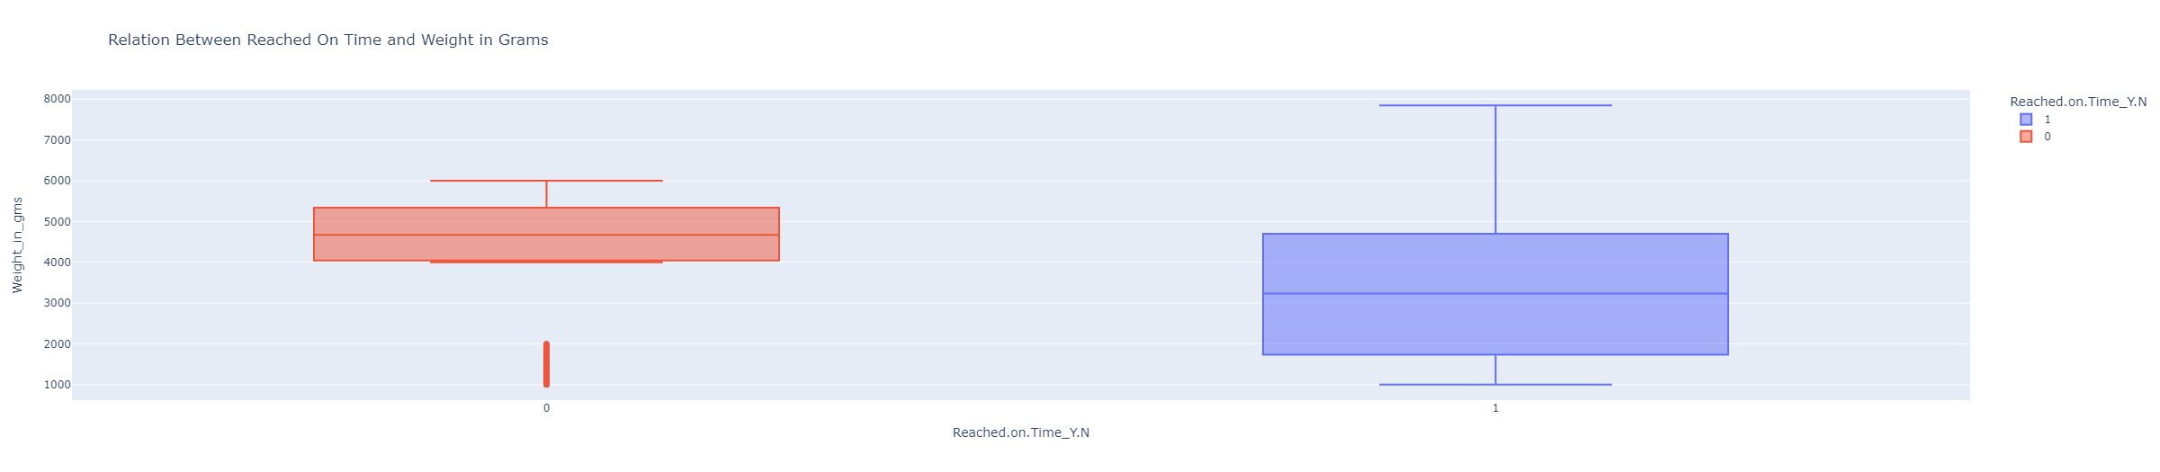
Relationship Between Reached On Time and Weight in Grams
This boxplot confirms my point in the previous slide.
Products that are delivered on time are the ones weigh more, it might be quantity of these products are relatively so they are usually shipped alone with the more expensive shipping plan.

Slide 15
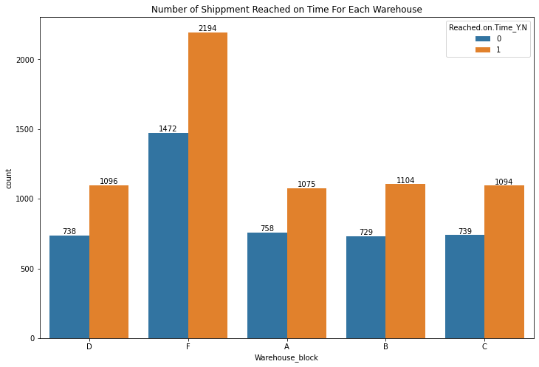
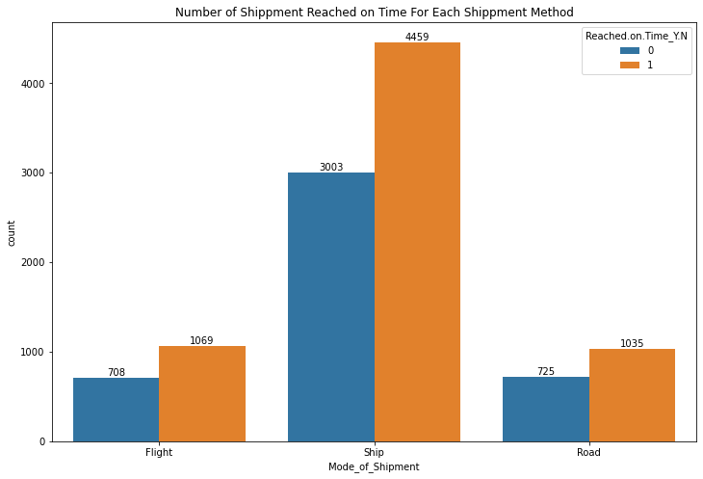
Reached On Time Distribution For Warehouse and Shipping Method
From both bar graphs, I can tell the service of products shipment is a general problem in the company.
From the marketing perspective, the company should first focus on improving their service to ensure more products are delivered on time to have more customers to stay loyal and generate more revenue.
The company should start on improving Warehouse F and Products that use ship to deliver because those two have the biggest quantity in sales, so it should be the focus of the company to improve as soon as possible.

Slide 16
Other Graphs
I have also plotted other graphs to explore the dataset in depth, but I did not find correlations between those variables.

Slide 17
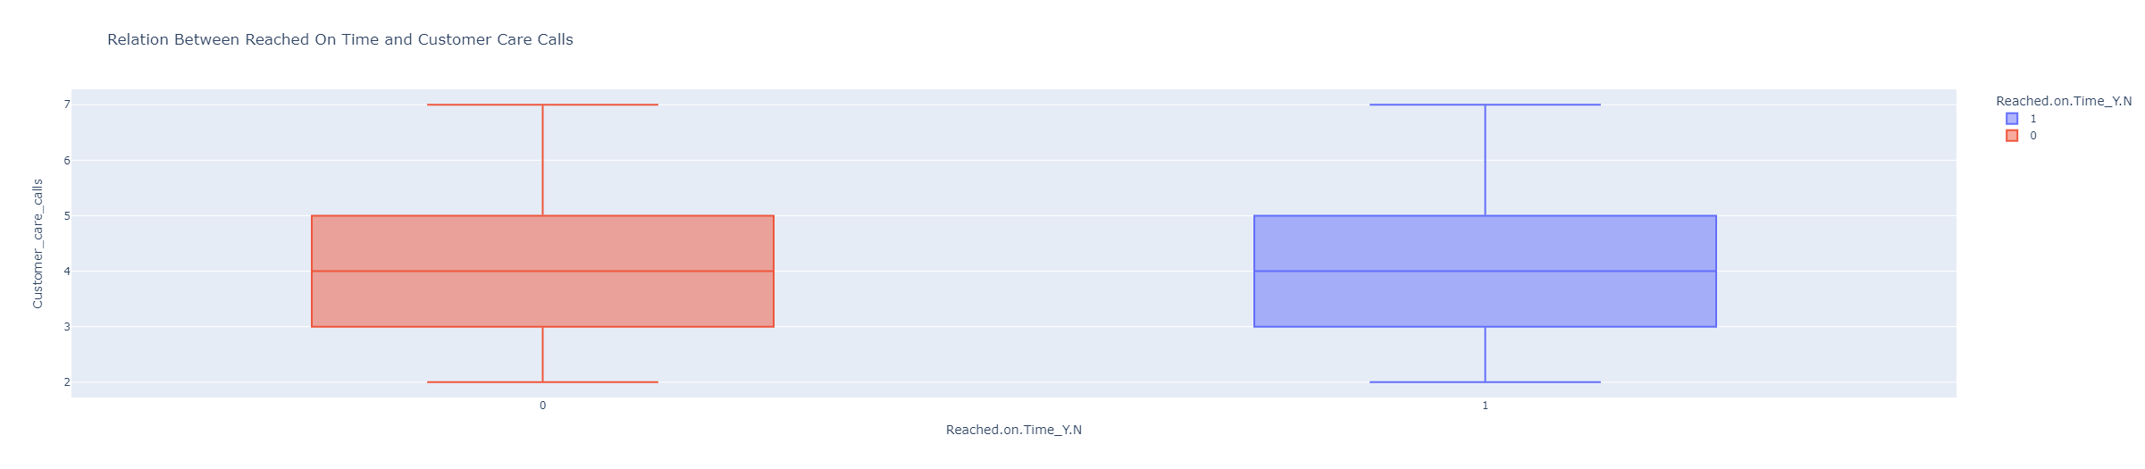
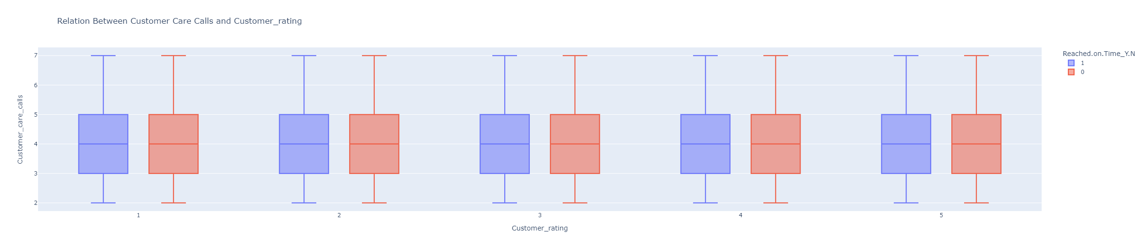
Other Graphs I Have Plotted

Slide 18
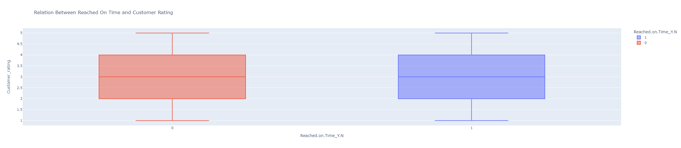
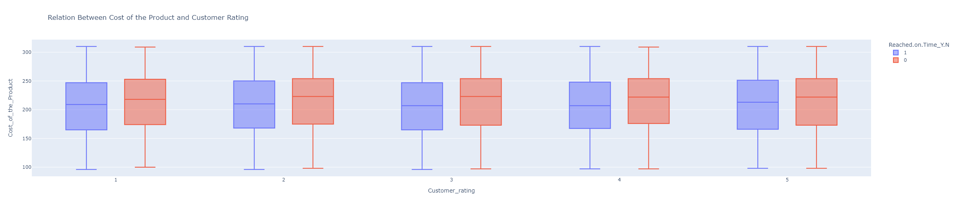
Other Graphs I Have Plotted

Slide 19
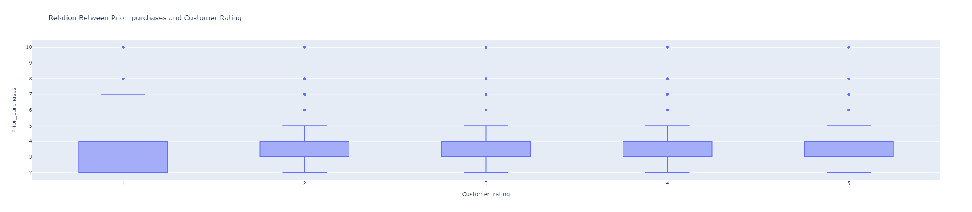
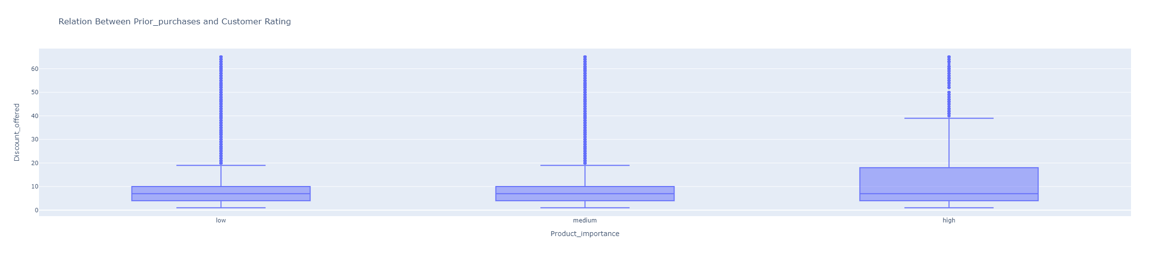
Other Graphs I Have Plotted

Slide 20
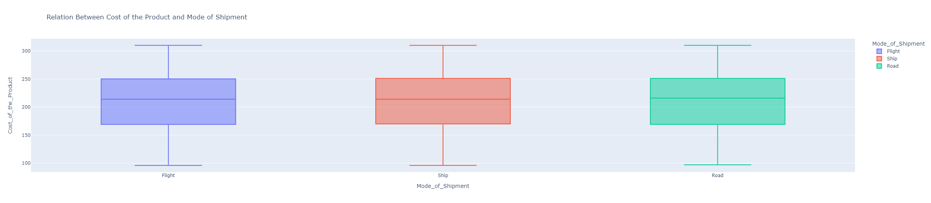
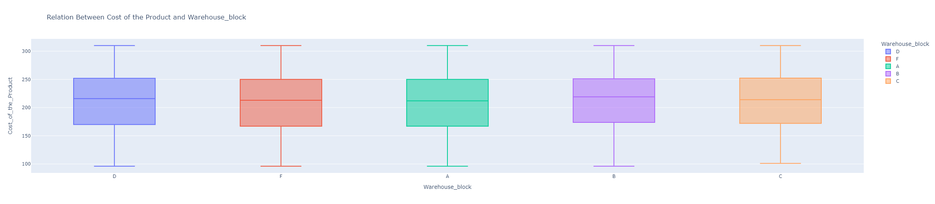
Other Graphs I Have Plotted

Slide 21
Use Machine Learning Models to Predict Reached On Time
Utilize all variables to predict whether a product would reach on time (excluding warehouse block, mode of shipment, and gender since they are not statistically significant)
Train Size: 80%
Test Size: 20%

Slide 22
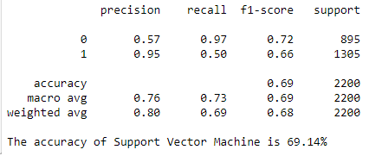
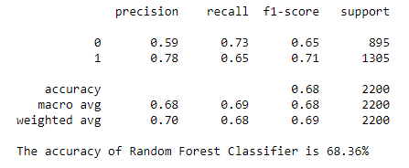
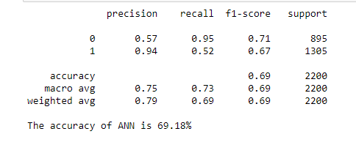
Predictions Comparison
Recall: sensitivity
F1-score: test performance (weighted average of precision and recall)
Support: actual occurrences
Artificial Neural Network has the best performance, but all accuracies are relatively low (might be due to low correlations between variables and small size of data)

Slide 23
Data Science Research Future Plans

Slide 24
Tools I Am Familiar With
Python
R
SQL
Tableau
Excel

Slide 25
Analysis I Have Conducted Before
Data Processing
Data Analyzing
Data Visualization
Time-series Analysis
Natural Language Processing
A/B Testing
Machine Learning

Slide 26
In Progress
Customer Segmentation
  “Customer segmentation is the practice of dividing a company's customers into groups that reflect similarity among customers in each group. The goal of segmenting customers is to decide how to relate to customers in each segment in order to maximize the value of each customer to the business.”
  Implement RFM (Recency, Frequency, Monetary) and uses machine learning
  Trying to categorize customers into 6 groups based on their loyalty, and practice designing new response strategies to target each customer group

Slide 27
Future Plans
Work on e-commerce data found on Kaggle and other websites (preferred to have 100,000 to 1,000,000 data)
Improve my ability in interpreting the dataset as well as the results of analysis to help business grows in a marketing perspective

Slide 28
Feature Engineering
“Feature engineering is the process of using domain knowledge to extract features from raw data. A feature is a property shared by independent units on which analysis or prediction is to be done. Features are used by predictive models and influence results.”
A predictive model that uses machine learning and statistical modeling to find most relevant characteristics within a dataset

Slide 29
Sales Prediction
After processing the data, we use machine learning techniques to train different models to make predictions for future customer purchases to grow the business and generate more revenue

Slide 30
Recommender System
In the age of Exabyte, e-commerce companies utilize large amount data generated by customers to create a filtering system that would predict customers’ behaviors
Used to recommend products, landing pages, or promotions to customers to increase conversion rates

